Slide 1

Online Book Store using Django
Presented by ~ TEAM 1

Slide 2
TEAM MEMBERS
TEAM – 1
S.B.JAI AKASSH ( TEAM LEAD )
PRAVEEN
E.ARTHEESH
ABIRAMI
MATHUMATHI
MANISHA
PRABHURAM

Slide 3
INTRODUCTION
Online bookstores are transforming the way users purchase and explore books.
Traditional systems lack personalization and smart content generation.
This project provides an AI-integrated web platform for browsing and purchasing books.

Slide 4
PROBLEM STATEMENT
Physical bookstores have limited accessibility.
Users often lack quick understanding of book content.
Manual management of books and categories is inefficient.
Need for a scalable and intelligent digital bookstore.

Slide 5
PROPOSED SOLUTION
We developed a Django-based Online Book Store Website with:
✅ Dynamic Book Listings
✅ User-Friendly Interface
✅ Cart System
✅ Admin Panel
✅ Newsletter Subscription
✅ AI-generated Book Summaries using Google Gemini API

Slide 6
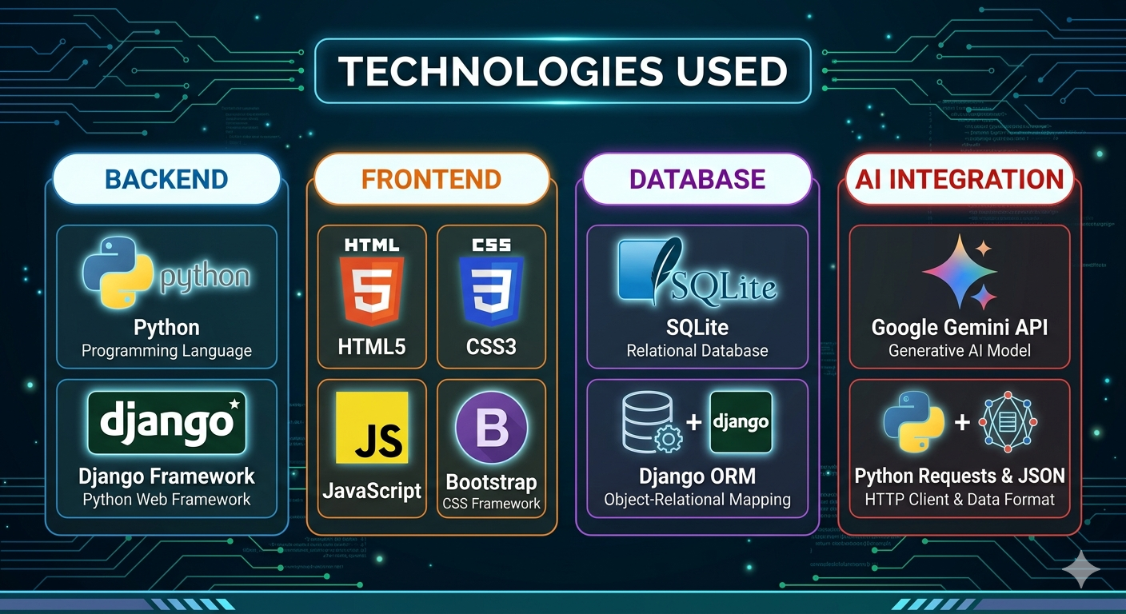
TECHNOLOGIES USED

Slide 7
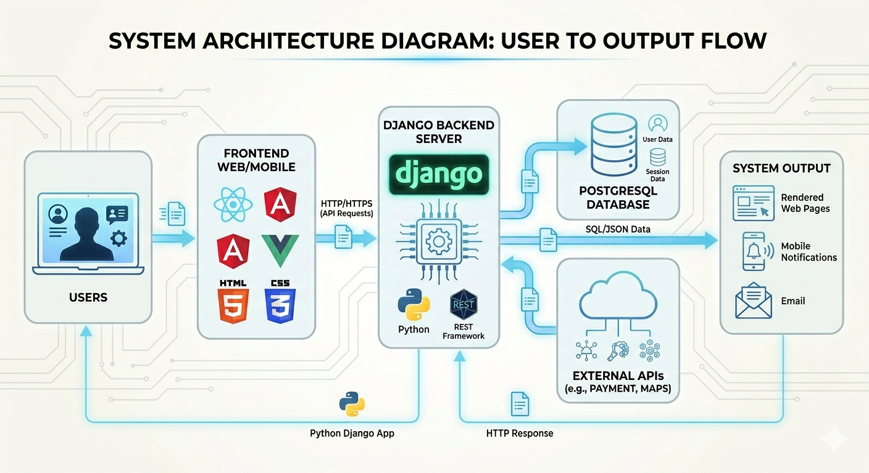
SYSTEM ARCHITECTURE

Slide 8
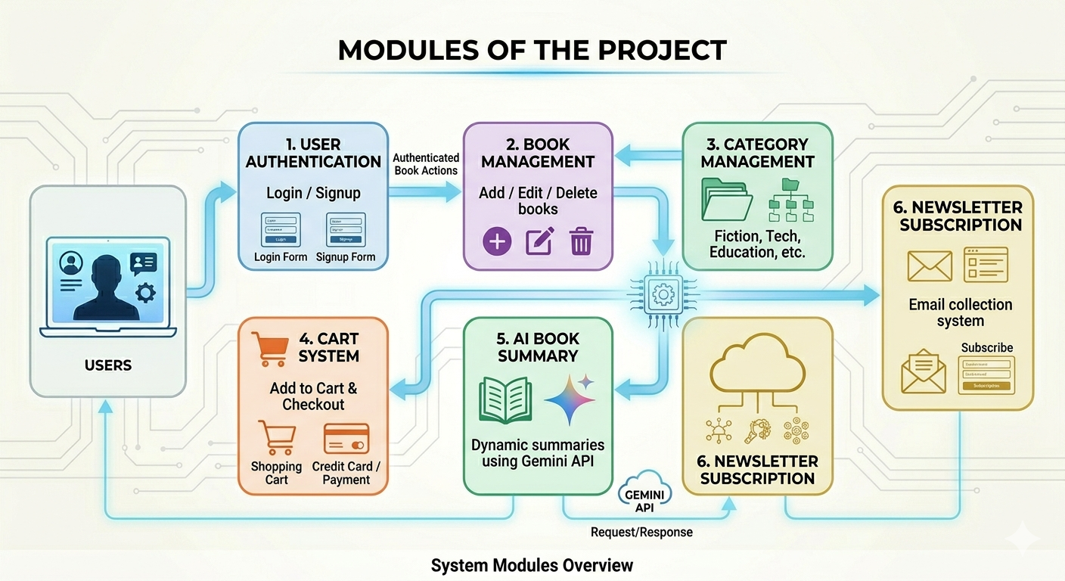
MODULES OF THE PROJECT

Slide 9
AI BOOK SUMMARY FEATURE
AI Integration using Google Gemini API
-Working:
User selects a book
Book title sent to Gemini API
AI generates summary
Summary displayed dynamically
-Advantages:
✅ Better user understanding ✅ Personalized experience ✅ Dynamic content generation

Slide 10
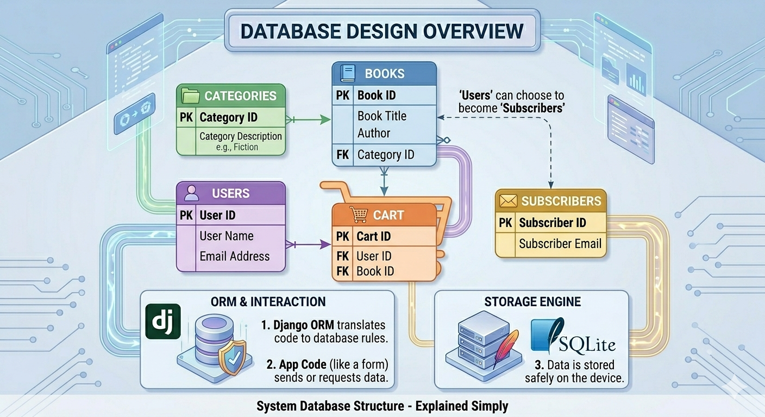

Slide 11
CART & CHECKOUT SYSTEM
Cart System
Add books to cart
View selected items
Dummy checkout process
Remove items from cart
Benefits:
Simulates real e-commerce workflow
Enhances user interaction

Slide 12
NEWSLETTER & ADMIN PANEL
Admin Panel
Manage books
Manage categories
View subscribers
Update featured sections
Newsletter Feature
Users subscribe using email
Emails stored securely in database

Slide 13
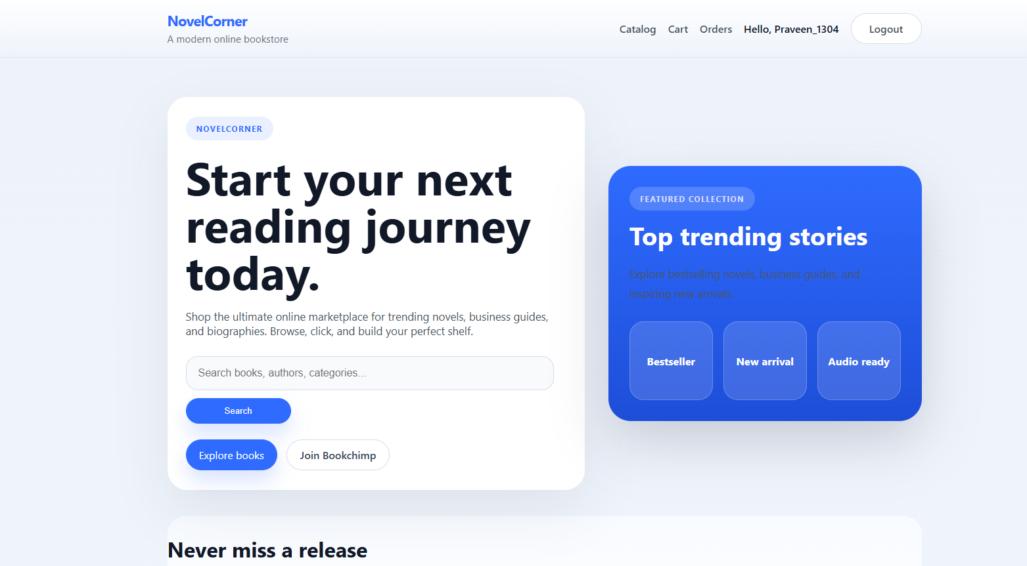
OUTPUT

Slide 14
RESULTS
Successfully developed full-stack bookstore website
Integrated AI-generated summaries
Implemented secure admin management
Built responsive UI
Implemented dynamic database operations

Slide 15
COCLUSION
The Online Book Store Website successfully demonstrates the integration of Django web development with AI-powered features. The system provides a scalable, secure, and intelligent platform for book browsing and management while enhancing user experience through dynamic content generation.

